Slide 1
EDA CREDIT ANALYSIS
NISHANTH FIONA

Slide 2
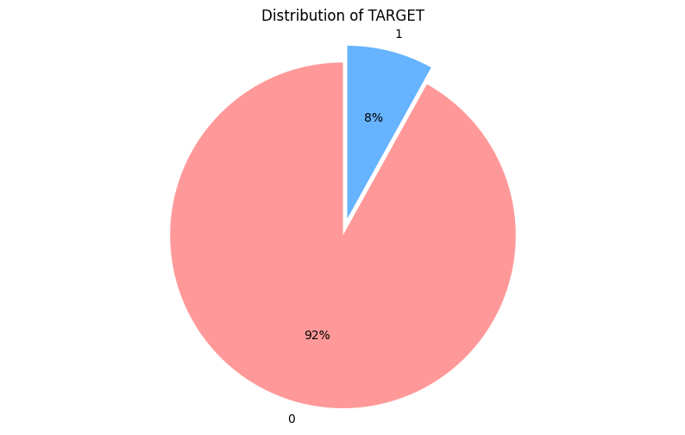
Due to the significantly higher number of non-defaulter records compared to defaulters, there is a risk that insights derived from this dataset may be biased towards non-defaulters. This imbalance might cause to overlook critical patterns and characteristics unique to defaulters.
If this dataset represents the entire bank's customer base, it indicates a strong prevalence of non-defaulters over defaulters. This insight suggests that the majority of the bank's customers are managing their repayments effectively. This also implies that our current methods and processes may be effective for the majority of our clients.
The data reveals that, on average, 1 out of every 12 customers is a defaulter, translating to a defaulter rate of approximately 8.33%. This ratio is crucial for understanding the bank's risk exposure and can inform strategies for risk management and customer support.

Slide 3
Assumptions Made:
Some outliers in both numerical and categorical columns were retained to analyze defaulter patterns.
2. For the Occupation Type column, which had a high percentage of missing values, the Income Type column was used to impute values. Specifically, for clients with an income type of "pensioner," "Retired" was introduced in the `Occupation` column.
3. Median imputation for missing values in EXT_SOURCE_3 resulted in numerous outliers below the lower fence of the boxplot, which were not removed and were considered valid.
4. Despite the bank dataset being biased towards non-defaulters, the assumption is that the proportion of defaulters in the sample is sufficiently high to provide meaningful insights.
5. High correlation was observed between Goods Price, Credit Amount, and Credit Annuity, which was assumed to reflect the bank's operational structure for loan provision.

Slide 4
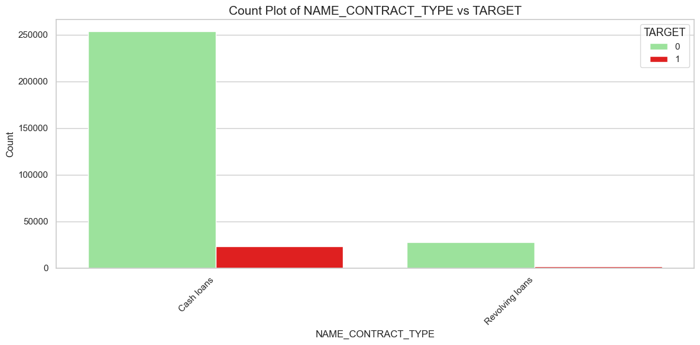
Customers who apply for revolving loans are more likely to repay their loans reliably.

Slide 5
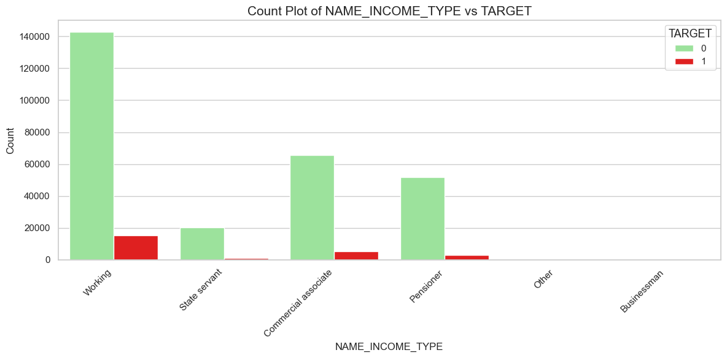
Approximately 10% of individuals with a working income type are at risk of defaulting.
The bank should consider targeting businesspeople more aggressively, as there is no observed default risk among clients with a business income type.

Slide 6
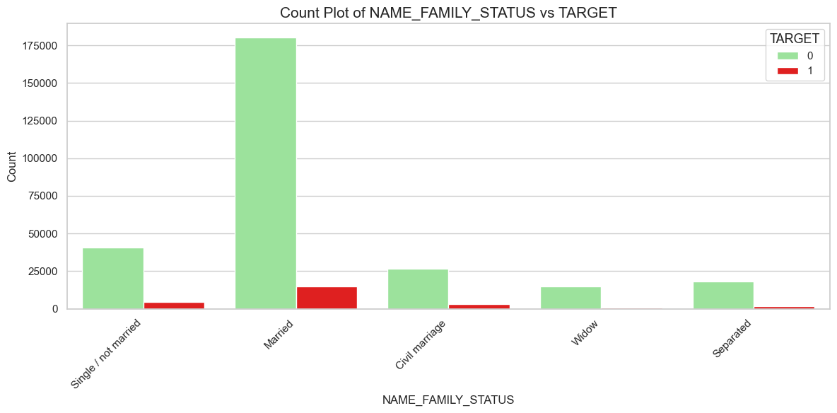
Married, single, and civil marriage clients show a higher number of defaulters compared to those who are widowed or separated

Slide 7
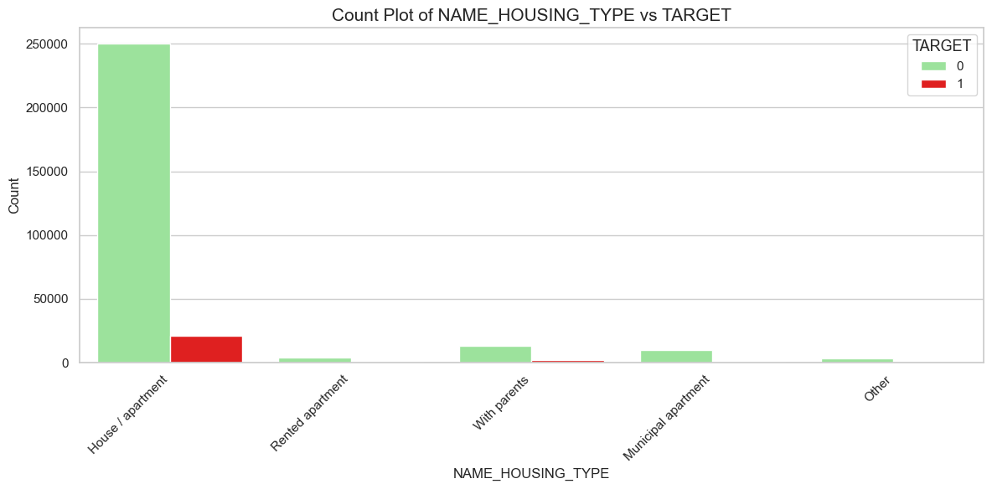
Clients who live in their own house or apartment, as well as those staying with their parents, are more likely to default.

Slide 8
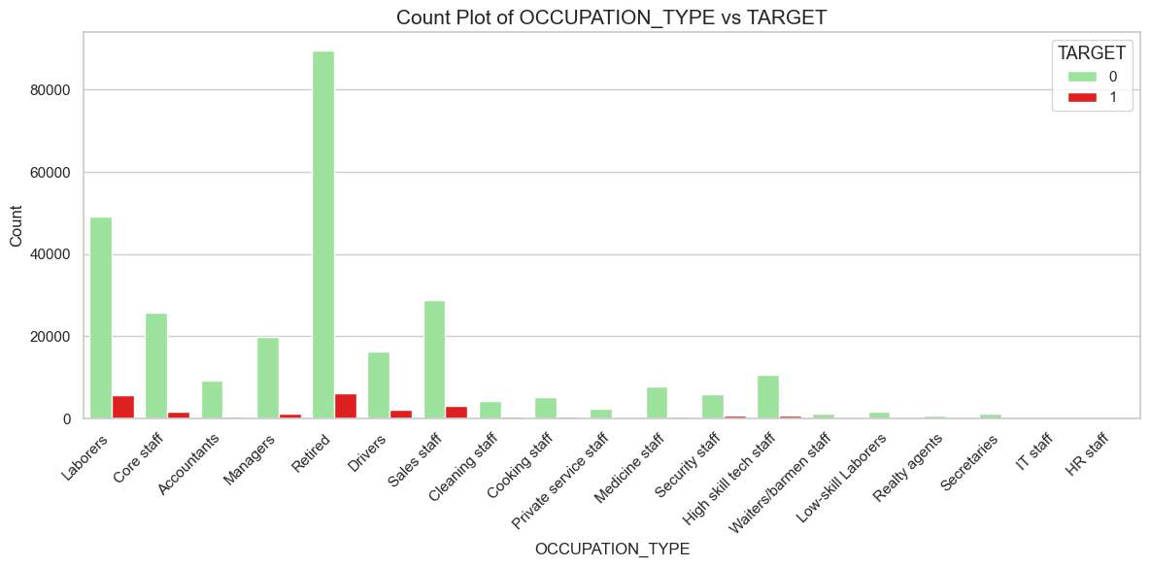
Retirees, laborers, sales staff, drivers, and core staff have a higher likelihood of defaulting.

Slide 9
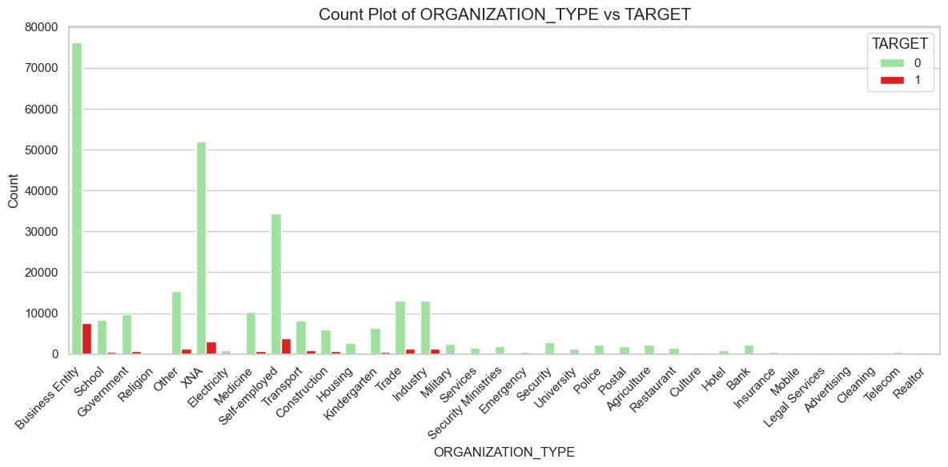
Clients working in business entities or as self-employed individuals are more likely to default.
The bank should enhance data collection accuracy regarding the type of organization where clients are employed

Slide 10
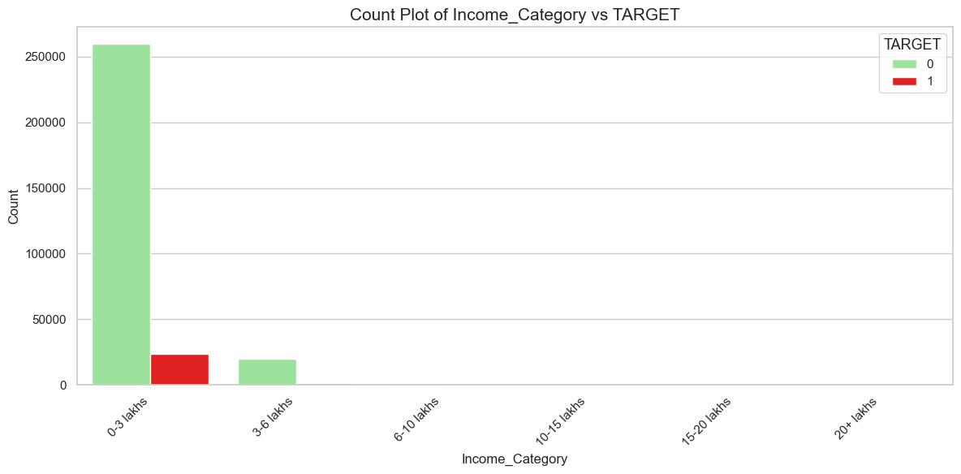
Clients earning less than 3 lakhs are more likely to default.

Slide 11
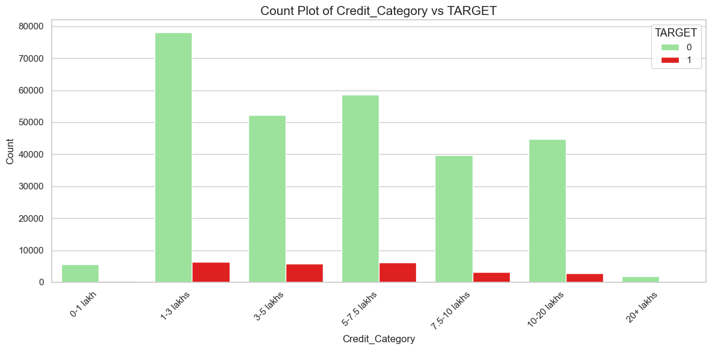
Bank can provide loan of less than 1lakh and higher than 20lakhs which are less likely to default.

Slide 12
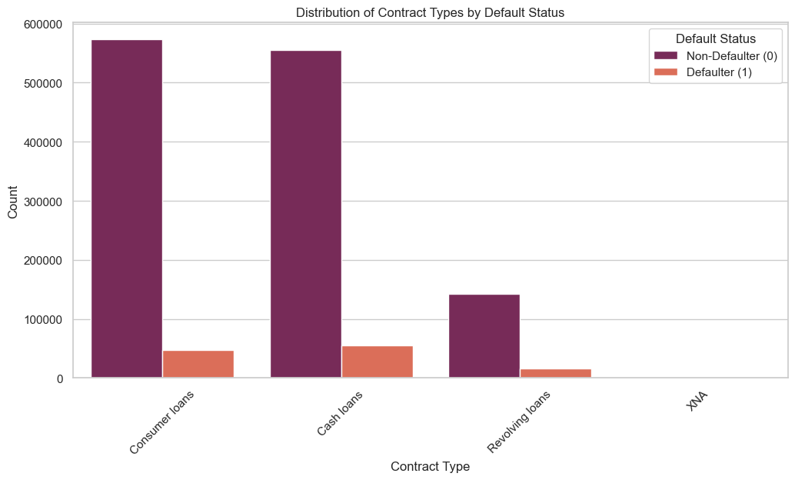
Despite the presence of defaulters in revolving loans in previous applications, the current data shows no defaulters in this category. This significant reduction suggests that the bank has effectively managed or mitigated the risk associated with revolving loans over time.

Slide 13
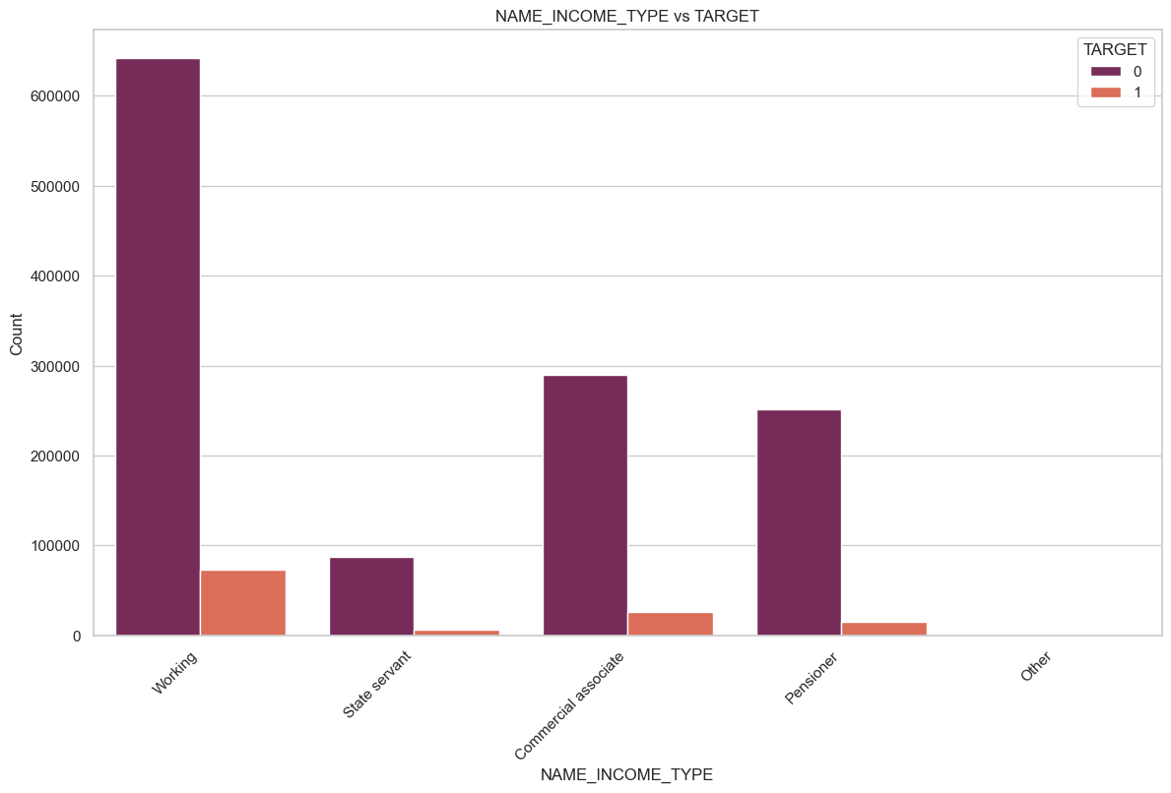
Working and Commercial associate are likely to be Defaulter

Slide 14
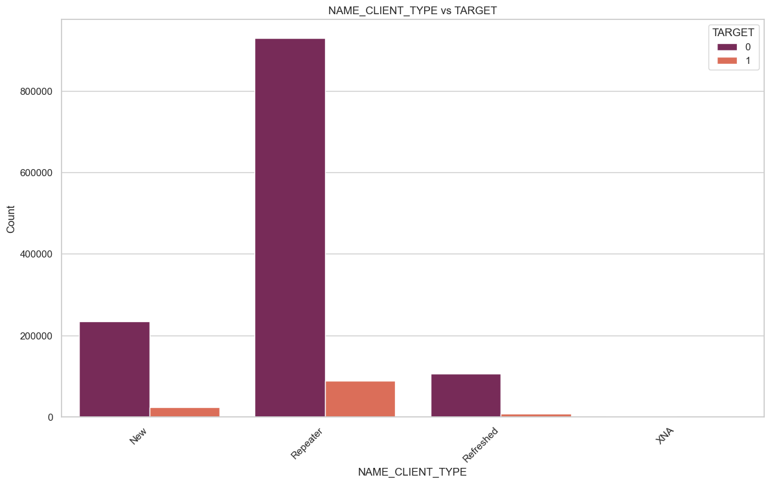
Repeated customer are likely to be defaulter.

Slide 15
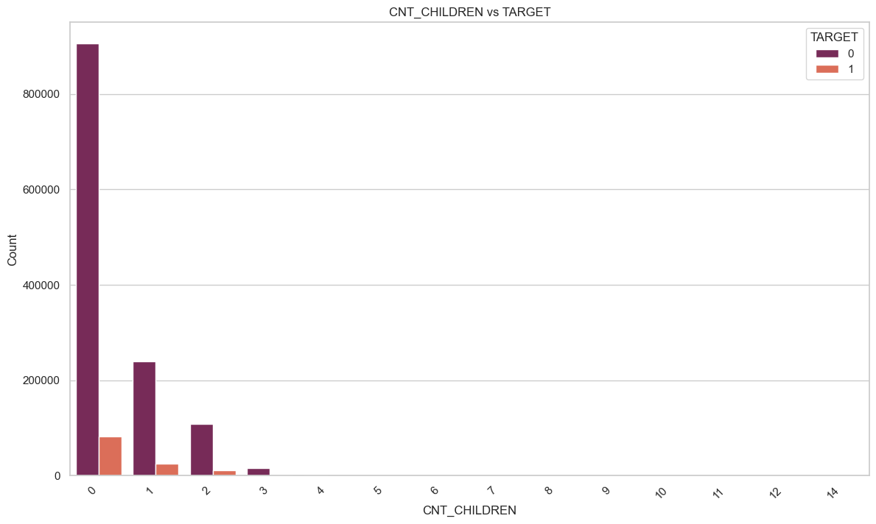
Client without any children or 1 - 2 Children are likely to be defaulter

Slide 16
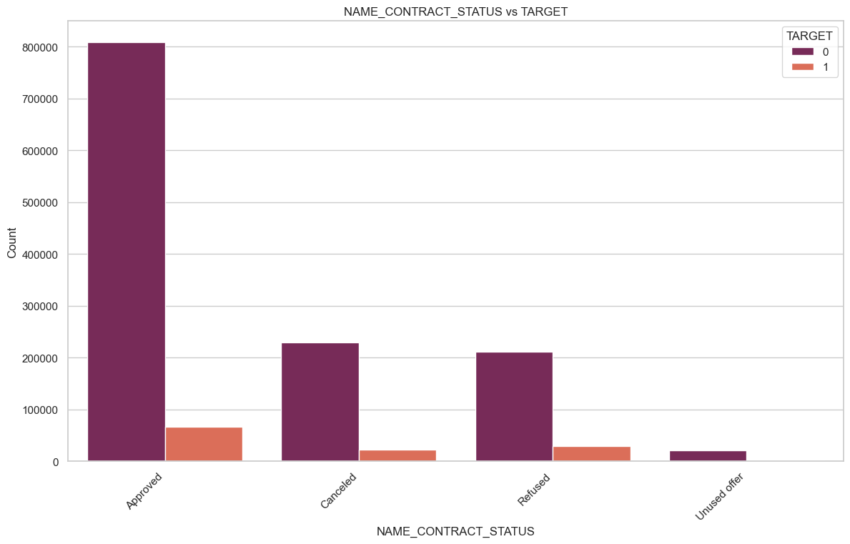
Client who loan approved, Refused are likely to default

Slide 17
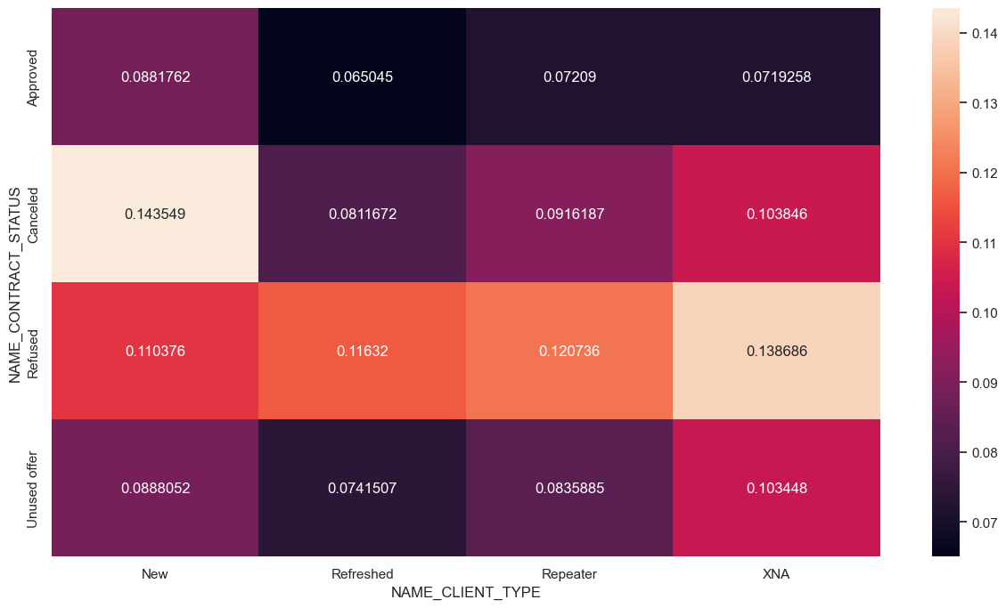
New Clients whose Contract type is Cancelled are likely to be defaulter.

Slide 18
Suggestions for Bank:
The data reveals that, on average, 1 out of every 12 customers is a defaulter, translating to a defaulter rate of approximately 8.33%. This ratio is crucial for understanding the bank's risk exposure and can inform strategies for risk management and customer support.
Bank should collect more record about defaulters since current dataset is biased.
Bank should consider lending loan to Businessman since defaulting is 0% in it.
Bank should consider collecting more information of expense patter for clients who has salary of 0-3lakhs before lending loan.
Bank should consider before providing loan to working class people.
Bank should consider before probiding loan to Sales Staff, Drivers, Labourers and Retired occupation type.
Clients who works in Business Entity are likely to default.
Repeated clients has a pattern of likely to default.
--------- Thank You --------

